Slide 1
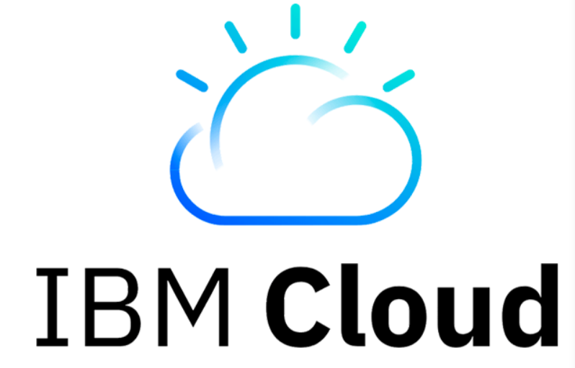
CLOUD STORAGE
Team 3
Chaitanya Subhash
Srinija
Swaroop
Viswanth
Priyanka

Slide 2
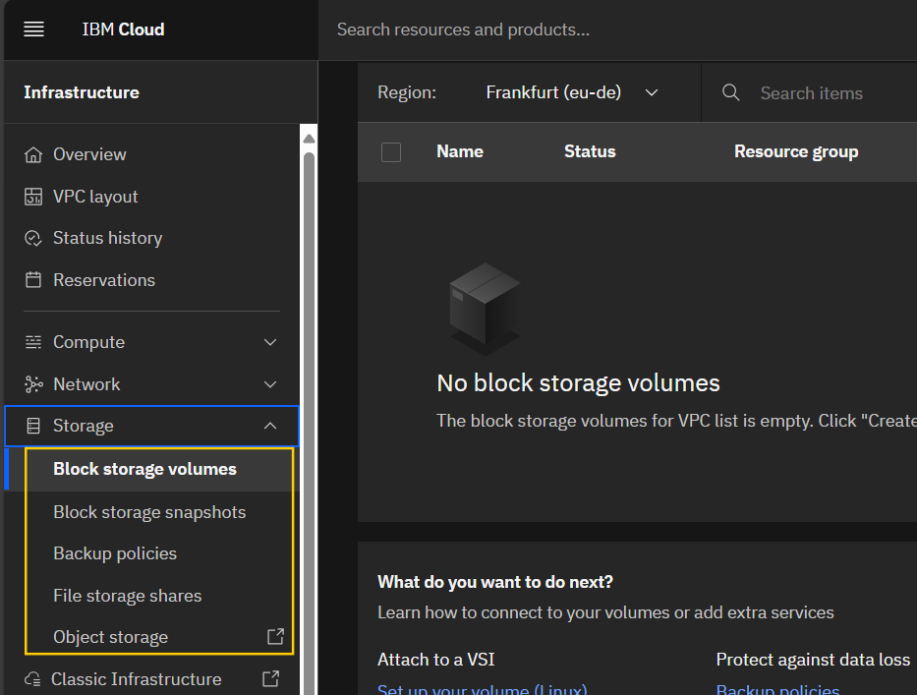
IBM STORAGE ACCOUNTS
There are 3 main storage accounts in IBM
Object Storage
Data protection, Large data storage,
Datastore for AI workloads.
Block Storage
Dynamic data allocation, Disaster recovery,
fast container storage.
File Storage
NFS based file services,
Flexible capacity customization,

Slide 3
STORAGE BENEFITS
Diverse Portfolio
Scalability & Flexibility
Cost-Effective Options
Hybrid Cloud Integration

Slide 4
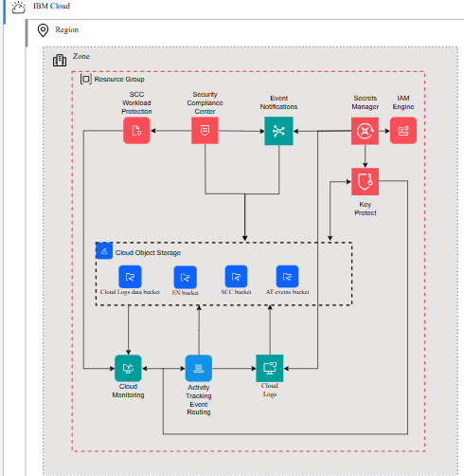
IBM Cloud Security
IBM Cloud SCC address unified security, compliance and risk visibility across hybrid multicloud environments.
Intro to IBM Cloud Security and Compliance Center
Some of the products which are part of SCC.
IBM cloud security & observability services.
IBM cloud secrets manager.
IBM cloud key product
IBM cloud monitoring.

Slide 5
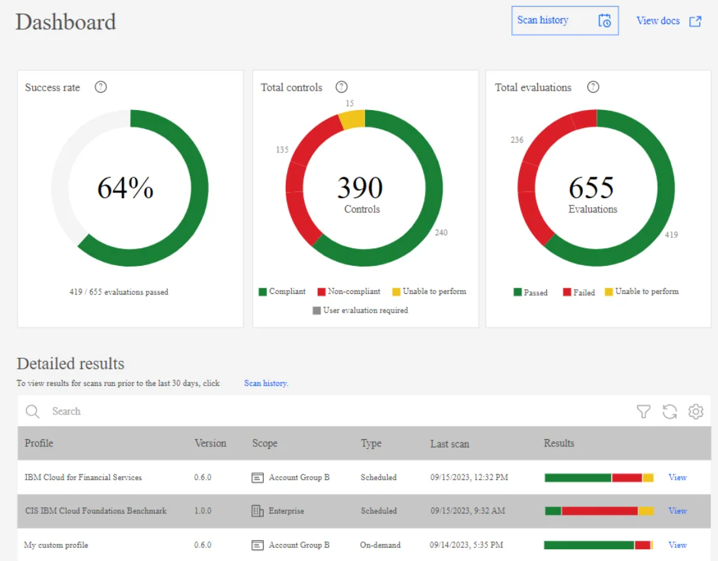
Cloud Security (Contd..)
Built-in Security
Data Immutability (Object Storage)
Key Protect
Virtual Private Cloud (VPC) Support

Slide 6
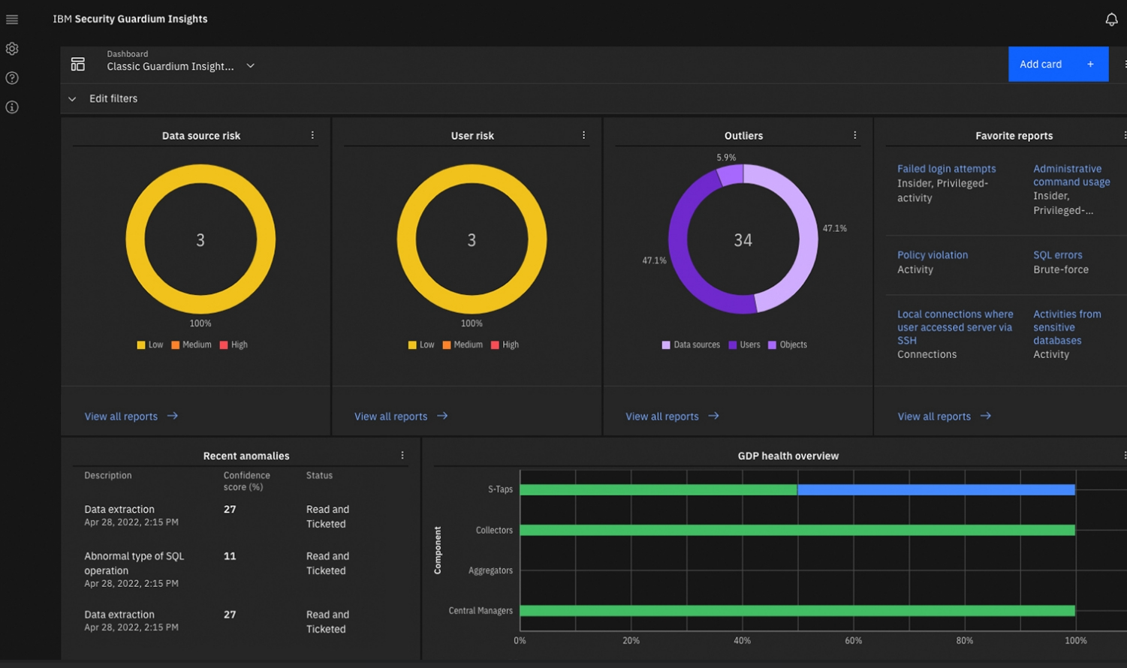
IBM Guardium
IBM Guardium Data security enter contains 5 modules (DSPM, DDR, Data Complaince, AI security, Quantum safe) to protect data from risks. https://www.youtube.com/watch?v=_UtE_JdmWHE

Slide 7
Geo Redundancy features
Cross-region replication for IBM Cloud File Storage for VPC.
Data replication – Cloud object storage.
Geo- replicated disaster recovery.
IBM cloud satellite.
IBM Cloud Now: Data Replication for Db2WoC, Geo-Replicated Disaster Recovery, and Resource Templates

Slide 8
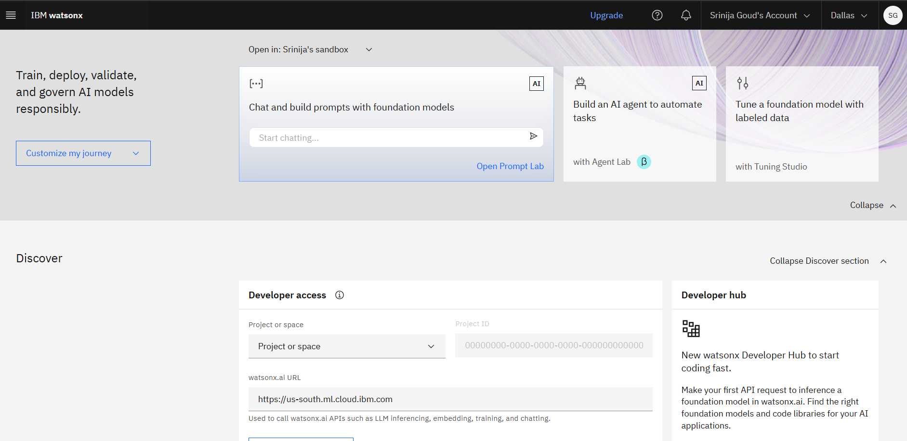
Role of AI in IBM cloud
1. IBM WatsonX.
IBM watsonx Simplified | What is watsonx.ai ~ Practical Demonstration | watsonx.ai Playground.

Slide 9
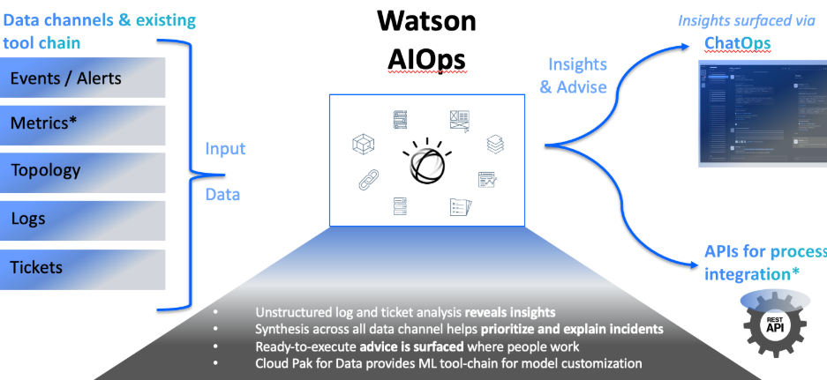
AI in IBM cloud(contd..)
2. IBM Watson AIOps.
3. IBM Granite model.

Slide 10
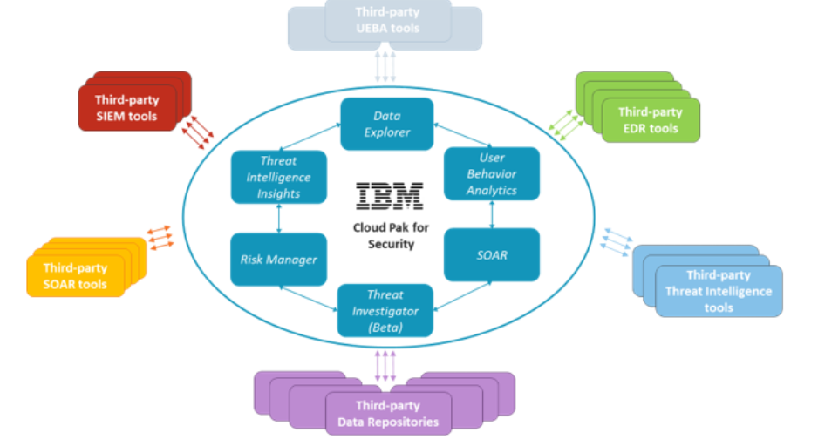
AI in IBM cloud(contd..)
4. IBM Cloud Pak for Data as a Service is a service platform that includes IBM watsonx.ai Studio

Slide 11
THANK YOU

